Slide 1

INDUSTRY
AWARDS 2026
SPONSORSHIP OPPORTUNITIES
22 October | The Brewery

Slide 2
ABOUT BESA
The Building Engineering Services Association (BESA) is a leading trade organisation that represents and supports businesses involved in the design, installation, operation, and maintenance of building engineering systems. Founded in 1904, BESA champions best practices, innovation, and professionalism across the building services sector, including critical areas like heating, ventilation,
air conditioning, refrigeration, and renewable energy systems.
ABOUT THE AWARDS
The BESA Industry Awards celebrate excellence, innovation, and leadership across the building engineering services sector. Recognised as one of the most influential events in the industry calendar, the awards shine a spotlight on the organisations and individuals driving positive change in building safety, sustainability, performance, and skills development.
Last year, over 500 professionals from across the supply chain—from contractors and consultants to manufacturers, educators, and emerging talent—come together to honour achievements that are shaping the future of the built environment.

Slide 3
AUDIENCE
AND REACH
530
16
141
ATTENDEES
SPONSORS
AWARDS ENTRIES
27.5k
157k
23%
150k
SOCIAL REACH
EMAIL REACH
EMAIL OPEN RATE
WEBSITE VISITORS

Slide 4
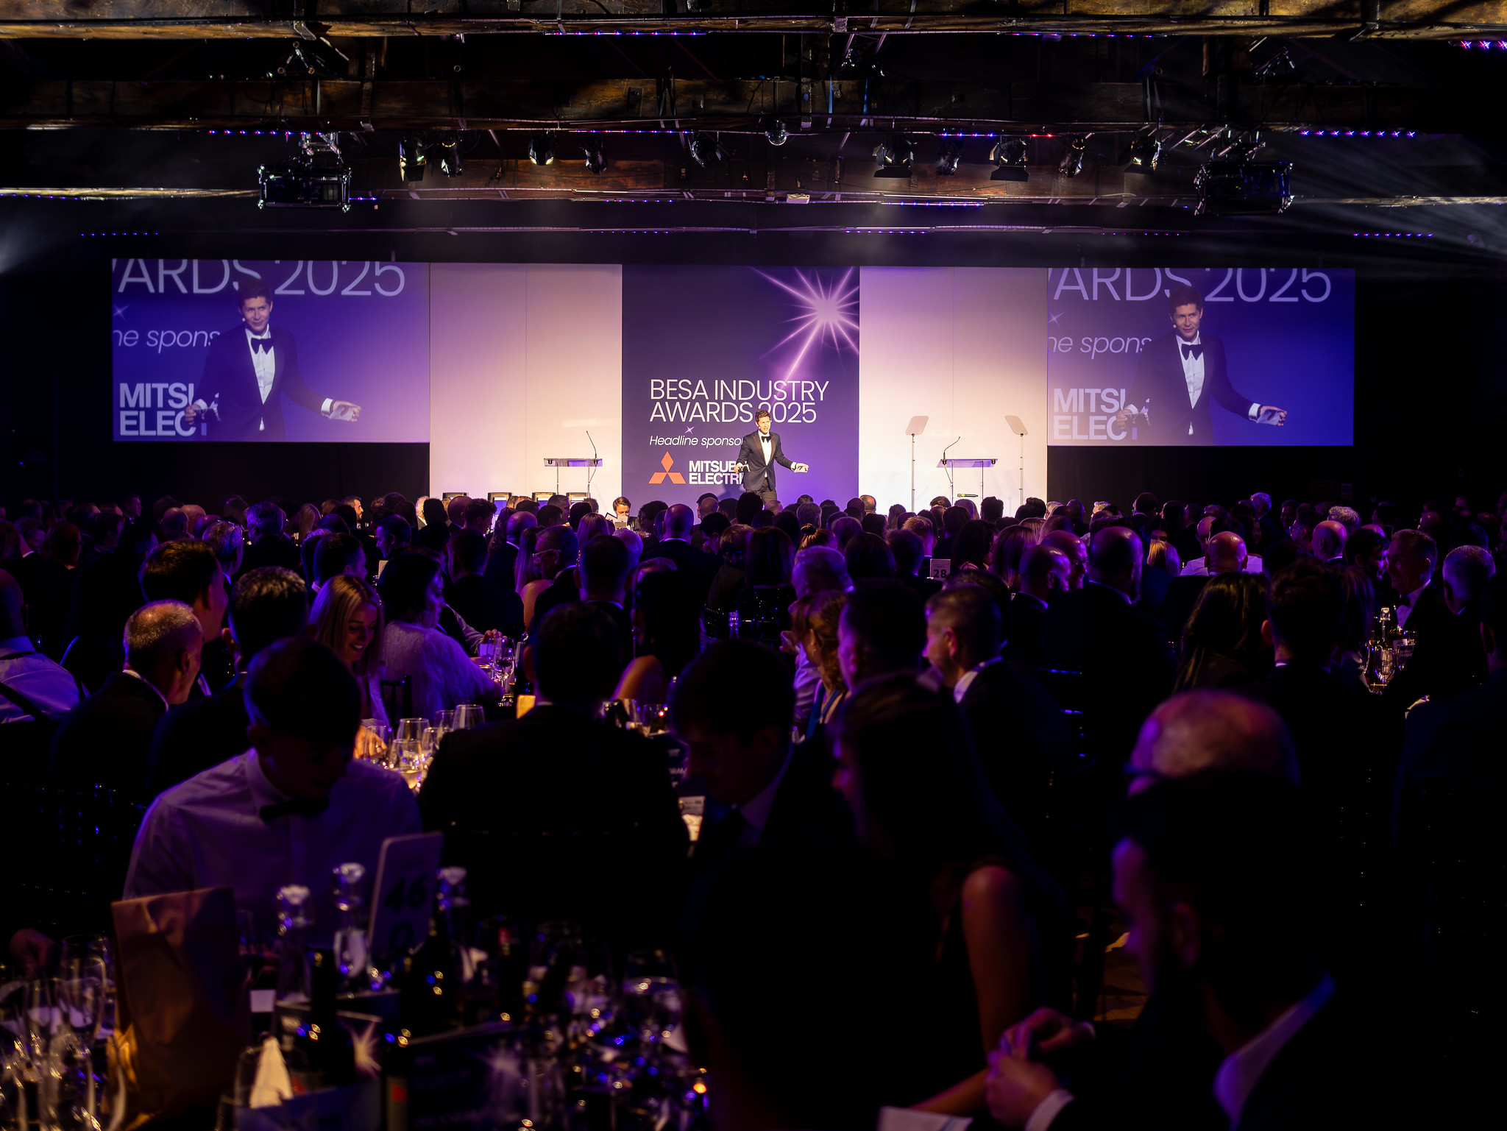
WHY SPONSOR?
BOOST BRAND AWARENESS
Gain direct exposure to building services professionals through our event marketing.
COMMITMENT TO INDUSTRY GROWTH
Demonstrate your dedication to talent development and business success.
SUPPORT FUTURE LEADERS
Be champions for workplace development and support the next generation.
BUILD CONNECTIONS
Network face-to-face and forge meaningful relationships.

Slide 5
SPONSORSHIP PACKAGES
HEADLINE
AFTER PARTY
Receive positioning as headline sponsor on all pre and post marketing collateral.
Thanks to be given in BESA President’s opening speech.
Full page advert in the Awards Menu.
Receive opt in data of all guests.
1x premium plus tables of 10 at the awards dinner.
Award category of your choice.
Company name on trophy.
Representative to present award.
Sparkling wine and VIP meeting point at the drink's reception.
Logo on shortlist and winner’s logo used on social.
Receive positioning as after party sponsor on all pre and post marketing collateral.
Personalised bar branding and option to provide branded T-shirts for bar staff.
Thanks to be given in the closing speech.
Full page advert in the Awards menu.
1x premium plus tables of 10 at the awards dinner.
Award category of your choice.
Company name on trophy.
Representative to present award.
Sparkling wine and VIP meeting point at the after party.
Logo on shortlisted and winner’s logo used on social.

Slide 6
SPONSORSHIP PACKAGES
CHILL-OUT LOUNGE
CATEGORY
Receive positioning as lounge sponsor on all pre and post marketing collateral.
Full page advert in awards menu.
1x premium plus tables of 10 at the awards dinner.
Award category of your choice.
Company name on trophy.
Representative to present award.
Sparkling wine and VIP meeting point at the drink's reception.
Logo on shortlist and winner’s logo used on social.
Branded lounge room including branded wall vinyls, soft furnishings, branded bar and back lit signage
Receive positioning as category sponsor on all pre and post marketing collateral.
1x premium plus tables of 10 at the awards dinner.
Award category of your choice.
Company name on trophy.
Meeting point at the drinks reception.
Logo on shortlisted and winner’s logo used on social.

Slide 7
SPONSORSHIP PACKAGES
Re-book before the 1st February 2026 to secure the re-booking rate.
All sponsor and exhibitor packages are plus VAT
Sponsorship package | Member standard | Non-Member standard
Headline sponsor - SOLD | £19,300 | £24,000
Chill-out Lounge sponsor | £10,000 | £12,250
After Party sponsor | £5000 | £6,250
Category sponsor | £3,750 | £5000
Ticket package | Member standard | Non-Member standard
Single Ticket | £275 | £350
Table of 10 | £2500 | £3000

Slide 8
CATEGORIES
Building Services (BSE) Apprentice
RAC and H&V Apprentice - SOLD
Facilities and Energy Manager Apprentice
Rising Star of the Year
Trainee of the Year - SOLD
Training Provider of the Year
Project of the Year – IAQ - SOLD
Project of the Year – under 500K
Project of the Year – over 500K - SOLD
Equality, Diversity and Inclusion
Product Innovation of the Year - SOLD
Learning and Development Initiative
Service and Maintenance Contractor of the Year - SOLD
Vent Hygiene Contractor of the Year
Excellence in Competence and Compliance - SOLD
Contractor Designer of the Year
Contractor of the Year – Under £5 Million - SOLD
Contractor of the Year – Over £5 Million – SOLD
National Contractor of the Year - SOLD
Distributor of the Year - SOLD
Manufacturer of the Year
President’s Award for Outstanding Achievement

Slide 9

TESTIMONIALS
Our team had a great evening at the BESA Group Industry Awards 2025 and we’re proud and grateful to share that we were named ‘Service & Maintenance Contractor of the Year.
We’re honoured to be recognised among so many outstanding organisations in our industry, and we’ll continue striving to deliver the best possible service for our clients and partners. “
Jody D, Business Development Manager, Gratte Brother Group
Great day at the Conference and Industry Awards 2025 — a fantastic conference followed by an evening prestigious award ceremony held at The Brewery, London, celebrating excellence across the building engineering services sector.
The event brought together the most respected people and companies in our industry — those who’ve gone above and beyond the call of duty for the greater good. From manufacturers and distributors through to contractors, and engineers.”
Andre Muhith, National Sales Manager, Milwaukee
What an incredible honour it was on Thursday night to receive the Service and Maintenance Apprentice of the Year award, is honestly something I never imagined when I first started my apprenticeship.
First and foremost, I want to say a massive thank you to BESA Group for recognising apprentices and the hard work that goes into learning and developing in this industry. It means a lot to know that the next generation of engineers is being supported and celebrated in this way.”
Lucas Danks, Apprentice, CMS
98% of delegates rated the awards a 5-star event and would be back in 2026

Slide 10
INDUSTRY
AWARDS 2026
GET IN TOUCH
To book your sponsorship package for the BESA Industry Awards
Please contact:
Charlie Ward
Charlie.ward@thebesa.com
+44 207 313 4906

